Slide 1
PACMULE (Payload Acquisition Carrier Multi-Utility Location Estimator) Initial Design Review
GPS-Denied Navigation Platform

Slide 2
The PACMULE Team
David Amanor
Telecommunications
Hardware Programming (VHDL/FPGA)
Signal Processing
Software – MATLAB
Tavin Clary
Telecommunications
Signal Processing
Software – MATLAB
Joshua Eddy
Autonomous Vehicle Design
Aircraft Stability and Control
Microcontrollers
Software – MATLAB, Python, Java
Niti Madhugiri
Astronomy
Image Processing
Robotic Motion Planning / AI
Software – MATLAB, Python, C
Nicole Ogden
Hardware Programming (VHDL/FPGA)
Microcontrollers – Arduino, Raspberry Pi, NETduino, BeagleBone Black
Software – MATLAB, C/C++, Android, Python
Robert Ryan
Visualization
Mechatronics
Software – Java, Android, Python, C/C++

Slide 3
GPS-Denied Navigation
Conditions:
Flying Donkey without Cargo Hold (i.e., no payload)
GPS disabled
Low-cost embedded solution (< $500 for navigation components)
Must carry organizer-supplied flight logger (60 g)
Criteria to win the sub-challenge:
Successfully complete a 1 km route, in both directions, at 8 a.m., noon and 5 p.m. (i.e. 6 km in total)
Out at 300m above ground level
Back at 50m above ground level
No damage to the aerial vehicle
Stay within the Flight Corridor
The winner will have the smallest average deviation from the Flight Corridor’s center line

Slide 4
A Three-Pronged System
The PACMULE will employ three navigation modules:
Inertial Measurement Unit
GSM Chipset
Computer Vision System

Slide 5
Why these three?
The PACMULE, at a bare minimum, should be able to determine orientation, position, and velocity. Ideally, PACMULE should be designed for maximal redundancy in the case of subsystem failure.
The three subsystems chosen for the PACMULE offer maximal sensory overlap to preclude the possibility of total sensory failure at any point.

Slide 6
Inertial Navigation
An IMU employs a combination of:
Accelerometer
Gyroscope
Compass
Barometer
Thermometer
By measuring accelerations and angular velocities, the PACMULE can make displacement estimates.

Slide 7
GSM Chipset
The GSM chipset communicates with nearby cell towers to ascertain:
Mobile Country Code
Mobile Network Code
Location Area Code
Cell ID
Signal Strength
This data can be employed to estimate the PACMULE’s position by trilateration.

Slide 8
Computer Vision System
Optical Flow Analysis compares two consecutively taken images to determine the flow of pixels, enabling estimations of velocity.
Horizon-Line Determination locates the horizon, allowing for orientation estimates.

Slide 9
Inertial Measurement Unit
IMU to Microcontroller
Output – Data Values
Smartphone Sensors
Output – Lat/Long
Output – Data Values

Slide 10
GSM Trilateration
GSM Chipset
Output – MCC, MNC, LAC, Cell ID, Signal Strength
Smartphone
Output – Lat/Long

Slide 11
Computer Vision
Night Vision Camera, into Raspberry Pi
Output – Velocity Vector
External Camera, interfaced to Smartphone
Output – Velocity Vector
Onboard Smartphone Camera
Output – Lat/Long
Output – Velocity Vector

Slide 12
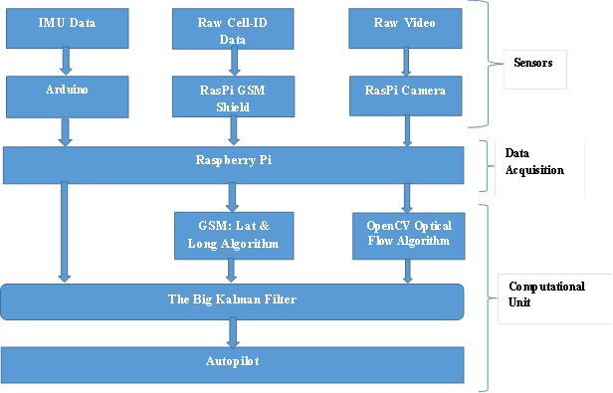
Package One
Languages: Python, C/C++, AT Commands
Adafruit IMU, GSM Shield, Night-Vision Camera into Raspberry Pi

Slide 13
Package One – Pros and Cons
Pros:
Modularity
Individual components are replaceable
Cons:
Complicated
Small Processor
Possible interfacing communication issues

Slide 14
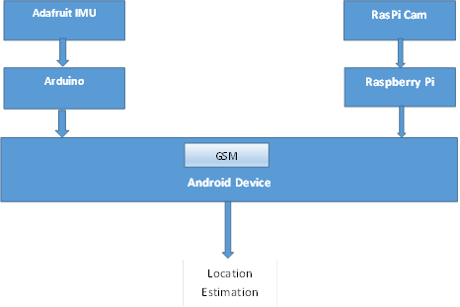
Package Two
Languages: Python, C/C++, Java or Python and Java
Either Adafruit IMU or Android IMU, Android Cell Phone, Night-Vision Camera into Raspberry Pi

Slide 15
Package Two – Pros and Cons
Pros:
Greater processing power
Less hardware interfacing
Cons:
Only one accessible hardware connection
Less customizable

Slide 16
Going from Simulation to Simulator
Simulation:
Representation of the Flying Donkey in an environment
Each component of the PACMULE represented within model
Simulator:
Adding Hardware-in-the-Loop (HIL) functionality

Slide 17
Simulation
Select 3D software capable of modeling both the PACMULE and the environment
PACMULE System-Level Model:
IMU Module IMU Arduino (HIL capable)
Cellular Tracking Module Smart Phone (HIL capable) or GSM
Image Processing Module Camera Raspberry Pi (HIL capable)
Vehicle
Terrain (ground, trees, rocks, buildings, gophers)
Environment (wind, lighting, gravity, cell signal, etc.)

Slide 18
Project Timeline
Week | Device Tasks |  |  |  | Simulation Tasks
4 | Modules |  |  |  | Coarse Models
5
6 |  | Packages |  |  |  | Fine Models
7 |  |  |  |  |  |  | Sim
8
9 |  |  | PACMULE |  |  |  |  | True Models
10 |  |  |  | Trials |  |  |  |  | HIL
11
12

Slide 19
“Opportunities to Excel”
The Learning Curve
Hardware Interfacing
Programming Languages
Visualization
Delivery Concerns
Subsystem Integration
Testing
Debugging / Unforeseen Issues
Budget
Vehicle interoperability

Slide 20
A Few Hanging Questions
What are NASA’s expectations?
For the Flying Donkey organizers:
Floor/ceiling altitudes? Required altitudes?
Exact specification of flight corridor?
Confirmation of given GPS landing zones?
Foreknowledge of waypoints? Competition timing?
Competitor-provided infrastructure?
Competition data logger?

Slide 21
Moving Forward
Select hardware and algorithms for each module
Hardware choices will likely dictate programming needs
Possible choices: Arduino UNO, Raspberry Pi, Samsung Galaxy S1
Possible Computer Vision algorithms: Lucas Kanade, Horn-Schunck
Select IDE’s based on programming needs
Possible choices: IDLE, Eclipse
Select visualization software
Possible choices: jMonkeyEngine, Microsoft Robotics Developer Studio, Panda3D

Slide 22
Thank you!

